Slide 1
Russia in Transition
1905-1924

Slide 2
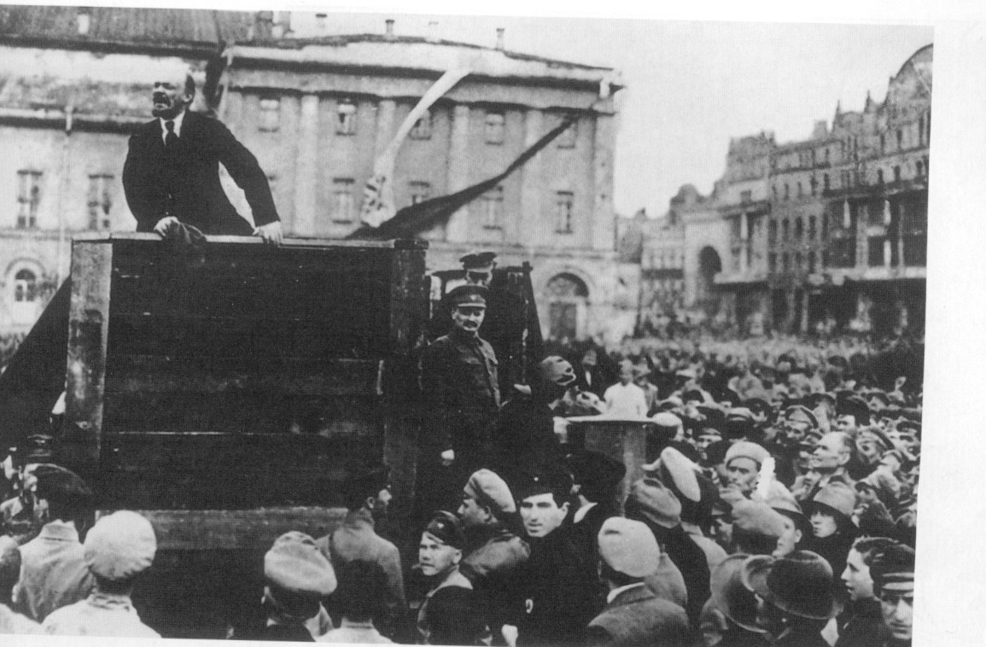

Slide 3
The October Revolution
The growing popularity of the Bolsheviks:
Membership of the party grew from 24,000 in February to 340,000 in October.
They had also formed their own army – the Red Guard which had been armed during the Kornilov Revolt.

Slide 4
Lenin’s Decision to seize power
Lenin was in exile in Finland but he was calling for a revolution.
He returned to Petrograd on October 7, 1917.
On the October 10, Lenin persuaded the party to agree to an uprising.
Kamenev and Zinoviev voiced strong objections.

Slide 5
Lenin’s Decision to seize power
They wrote a letter to a newspaper which told of their objections.
This alerted Kerensky who then tried to remove the Bolshevik threat – he closed down their newspapers.
He also tried to round up Bolsheviks.
The Bolsheviks were forced into action.

Slide 6
The role of Trotsky
In August Trotsky became a member of the Bolsheviks.
The Bolsheviks secured control of the Petrograd Soviet, Trotsky was elected as its leader.
In October he became the dominant members of the Military Revolutionary Committee (MRC) of the Soviet.

Slide 7
The role of Trotsky
The MRC – in theory – controlled 20,000 Red Guards, 60,000 Baltic sailors and 150,000 soldiers of the Petrograd garrison.
This meant the Bolsheviks controlled the army and could control the city itself.

Slide 8
The role of Trotsky
They started to plan for the revolution.
They reduced their demonstrations and street disturbances.
Small disciplined units of soldiers and workers were deployed.
They were going to overthrow the Provisional Government on October 24.

Slide 9
The revolution
Key buildings in Petrograd were captured – these were railway stations and telegraph offices.
Roadblocks were set up on the city’s bridges and surrounding the Winter Palace.
There was little resistance.
Kerensky escaped from Petrograd on October 25, the rest of the government remained.

Slide 10
The revolution
Kerensky tried to raise troops from the front. But he could not secure help.
Troops guarding the Provisional Government surrendered.
Red Guards placed the Provisional Government under arrest.

Slide 11
The Bolsheviks take power
At the same time the All-Russian Congress of Soviets – in which the Bolsheviks held 390 of the 650 seats – was meeting in Petrograd.
The SRs and the Mensheviks condemned the Bolshevik takeover – they left the Congress, placing the Bolsheviks in power.

Slide 12
The Bolsheviks take power
On October 26, Lenin formed the Council of the People’s Commissars.
Lenin was head of the government.
Trotsky was Commissar for Foreign Affairs.

Slide 13
The Bolsheviks take power
Within a week of the revolution in Petrograd, the Bolsheviks took control of Moscow.

Slide 14
Role of Lenin
He persuaded the Bolsheviks to oppose the war, unlike the SRs and Mensheviks.
He believed a workers revolution was possible.
He gave the Bolsheviks simple slogans – Peace, Land, Bread.
He helped increase party membership.

Slide 15
Role of Lenin
He created the Red Guard and used German money.
He was a superb orator
He had energy.

Slide 16
Bolshevik Revolution
Trotsky organized the takeover – refer to your earlier notes - but without Lenin the Bolsheviks would not have even tried to remove the Provisional Government.

Slide 17
EXAM QUESTIONS
Explain the failings of the Provisional Government. [5]
Explain the strengths of the Bolsheviks after the February Revolution [5]

Slide 18
was there so
Why was there so much opposition to the Bolsheviks?
Economic
Political

Slide 19
Group | Why were they angry with the Bolsheviks? | What were their strengths? | What were their weaknesses?
The Czech Legion
The Whites
The Greens
Foreign Powers

Slide 21
Foreign Powers fighting in the Russian Civil War
Countries | Explain the motive for joining the Civil War.
The Czech Legion
The Whites
The Greens
Foreign Powers

Slide 22
How did Trotsky inspire the Red Army?
Positive aspects of Trotsky’s leadership | Negative aspects of Trotsky’s leadership

Slide 23
Explain why the Tsar was murdered
Events leading to Tsar’s death | Reasons for the Tsar’s murder

Slide 24
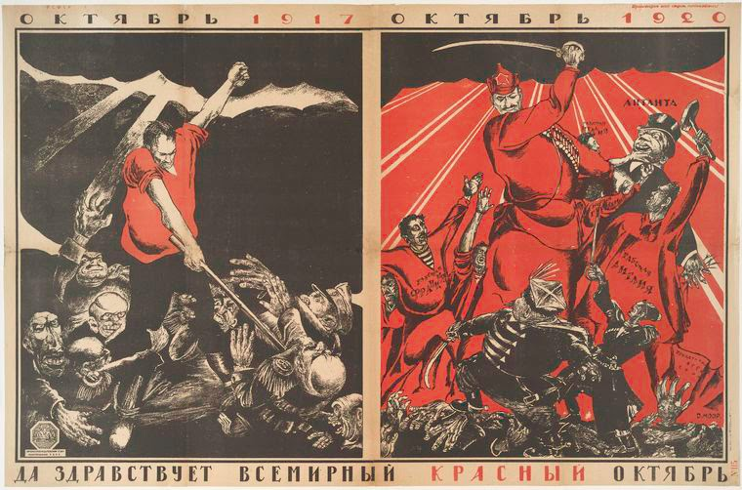
Civil War Propaganda
Describe what you see: What is the message of this poster?

Slide 25
was there so
What were the strengths and weaknesses of War Communism?
Strengths
Weaknesses

Slide 26
was there so
What were the weaknesses of the Whites?
Using the information on the pages, create a detailed mind map to explain the weaknesses of the Whites.

Slide 27
The Weaknesses of the Whites
Lack of Unity
Geographical Spread
Nationalist Groups
Weak support from foreign powers
Poor leadership
Arrange the weaknesses of the Whites into an order of importance – the most important should be at the top, the least important should be at the bottom.

