Slide 1
Linking GCSE, Thinking Skills and the PISA Reading Literacy Framework
10 Chwefror 2015

Slide 2
Extract from the PISA Reading Literacy Framework
“Cognitively-based theories of reading literacy emphasise the interactive nature of reading and the constructive nature of comprehension, in the print medium (Binkley & Linnakylä, 1997; Bruner, 1990; Dole, Duffy, Roehler, & Pearson, 1991) and to an even greater extent in the electronic medium (Fastrez, 2001; Legros & Crinon, 2002; Leu, 2007; Reinking, 1994). The reader generates meaning in response to text by using previous knowledge and a range of text and situational cues that are often socially and culturally derived. While constructing meaning, the reader uses various processes, skills, and strategies to foster, monitor, and maintain understanding. These processes and strategies are expected to vary with context and purpose as readers interact with multiple continuous and non-continuous texts both in print and (increasingly) when using digital technologies (Britt & Rouet, 2012)”.
(PISA 2015 pg.9)

Slide 3
Reading Literacy Aspects and Related Tasks
Access and Retrieve
Retrieving information tasks, which focus the reader on separate pieces of information within the text, are assigned to the access and retrieve scale. (PISA 2015 pg. 21)

Slide 4
Reading Literacy Aspects and Related Tasks
Integrate and Interpret
Forming a broad understanding and developing an interpretation tasks focus the reader on relationships within a text. Tasks that focus on the whole text require readers to form a broad understanding; tasks that focus on relationships between parts of the text require developing an interpretation. The two are grouped together under integrate and interpret. (PISA 2015 pg. 21)

Slide 5
Reading Literacy Aspects and Related Tasks
Reflect and Evaluate
Tasks addressing the last two aspects,
reflecting on the content of a text and reflecting on the form of a text, are grouped together into a single reflect and evaluate aspect category. Both require the reader to draw primarily on knowledge outside the text and relate it to what is being read. Reflecting on content tasks are concerned with the notional substance of a text; reflecting on form tasks are concerned with its structure or formal features. (PISA 2015 pg. 21)

Slide 6
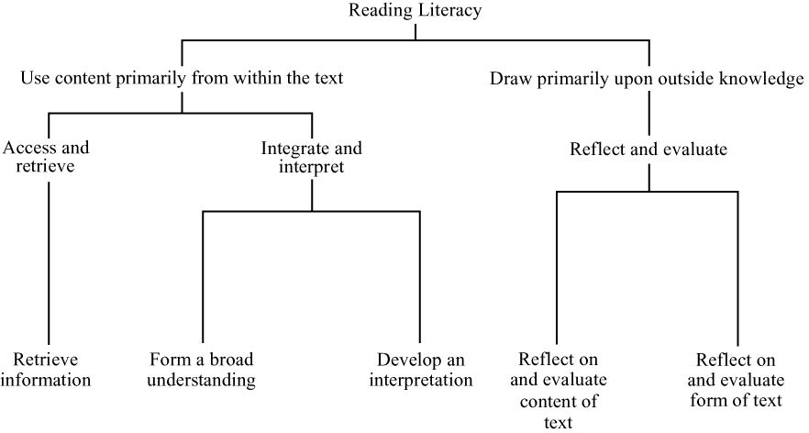
(PISA 2015 pg. 21)

Slide 7
The PISA 2009 definition of reading, continued for 2012 and 2015:
Reading literacy is understanding, using, reflecting on and engaging with written texts, in order to achieve one’s goals, to develop one’s knowledge and potential, and to participate in society.
We are going to focus on the underlined text above…

Slide 8
“Reading literacy includes a wide range of cognitive competencies, from basic decoding, to knowledge of words, grammar and larger linguistic and textual structures and features, to knowledge about the world. It also includes metacognitive competencies: the awareness of and ability to use a variety of appropriate strategies when processing texts.”
“Metacognitive competencies are activated when readers think about, monitor and adjust their reading activity for a particular goal.”

Slide 9
“The word using refers to the notions of application and function – doing something with what we read”
“The word understanding is readily connected with reading comprehension”
Even at the earliest stages, readers draw on symbolic knowledge to decode a text and require a knowledge of vocabulary to make meaning.
“Reflecting on is added to understanding and using to emphasise the notion that reading is interactive: readers draw on their own thoughts and experiences when engaging with a text”

Slide 10
Thinking Maps
Year 9 Ysgol Bryn Elian pupils have been using and producing maps within the units of work we are currently developing and trialling.
They have you used the Thinking Maps along with Concept Maps and the Lotus Diagram.

Slide 11
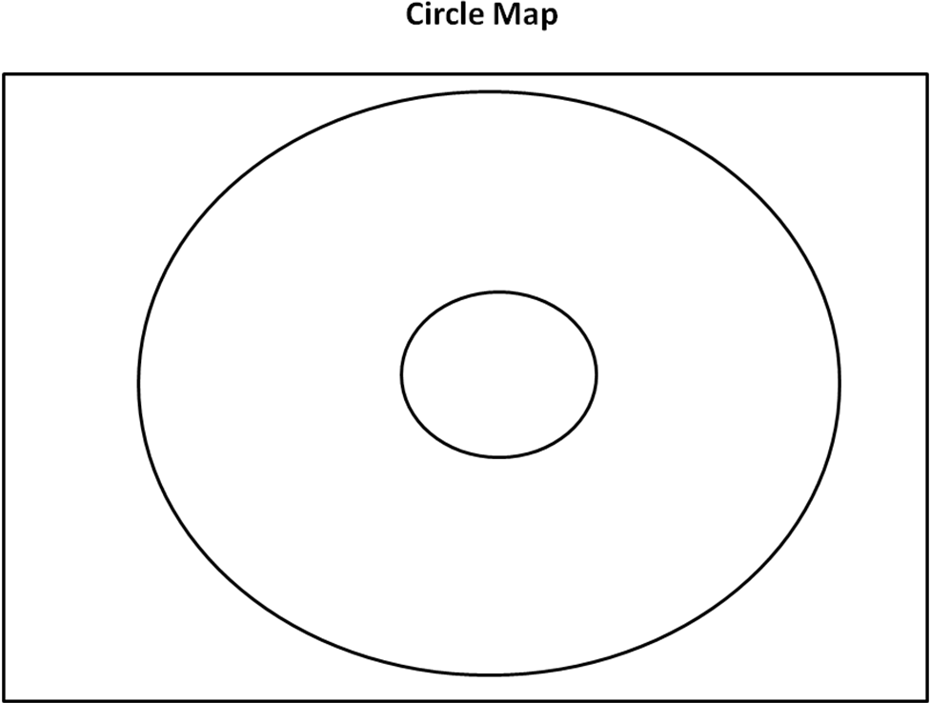

Slide 12
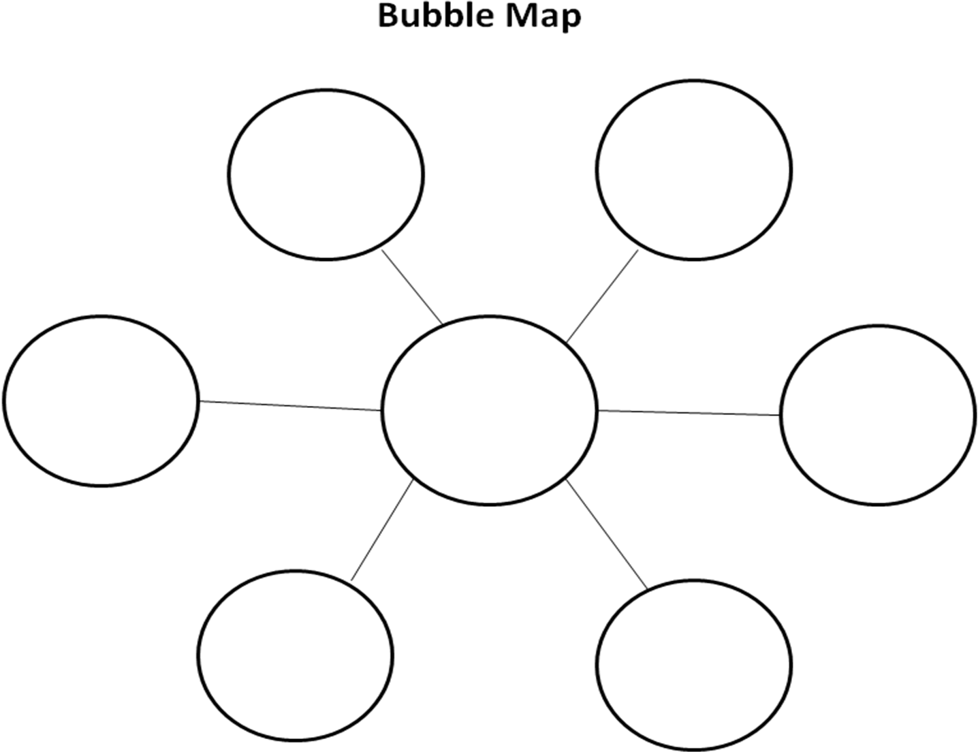

Slide 13
Double Bubble Map

Slide 14
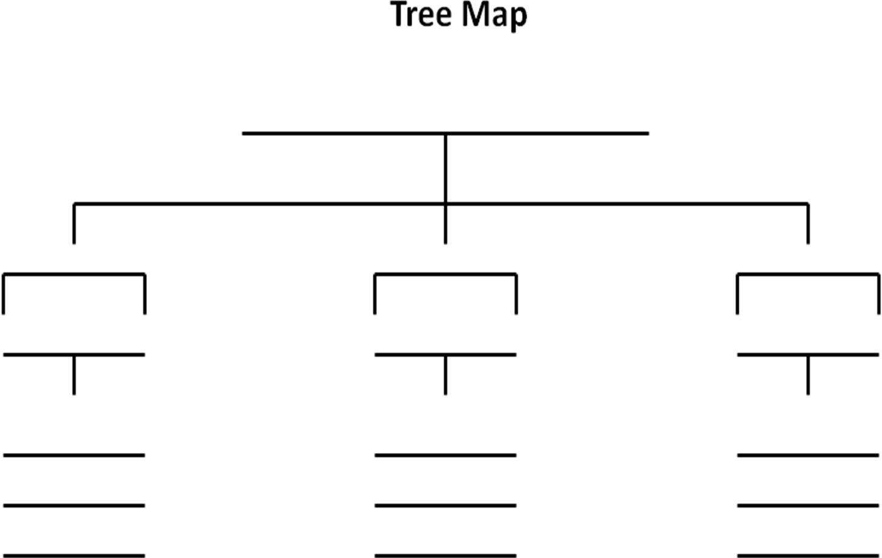

Slide 15
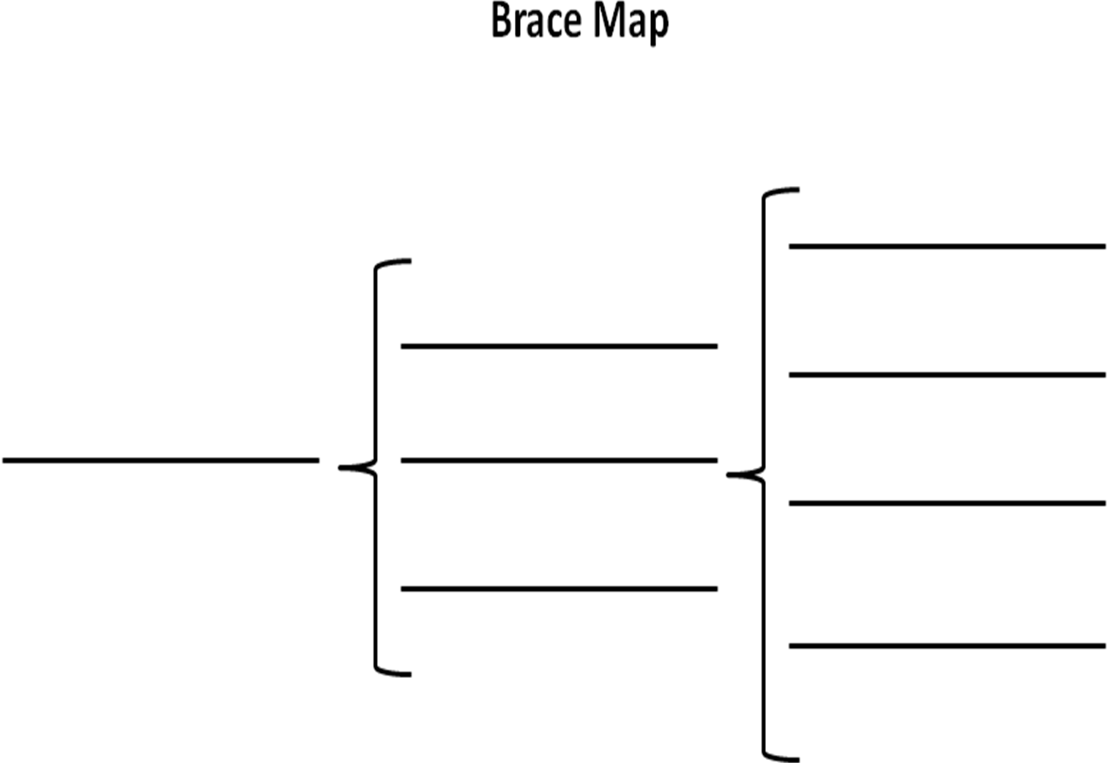

Slide 16
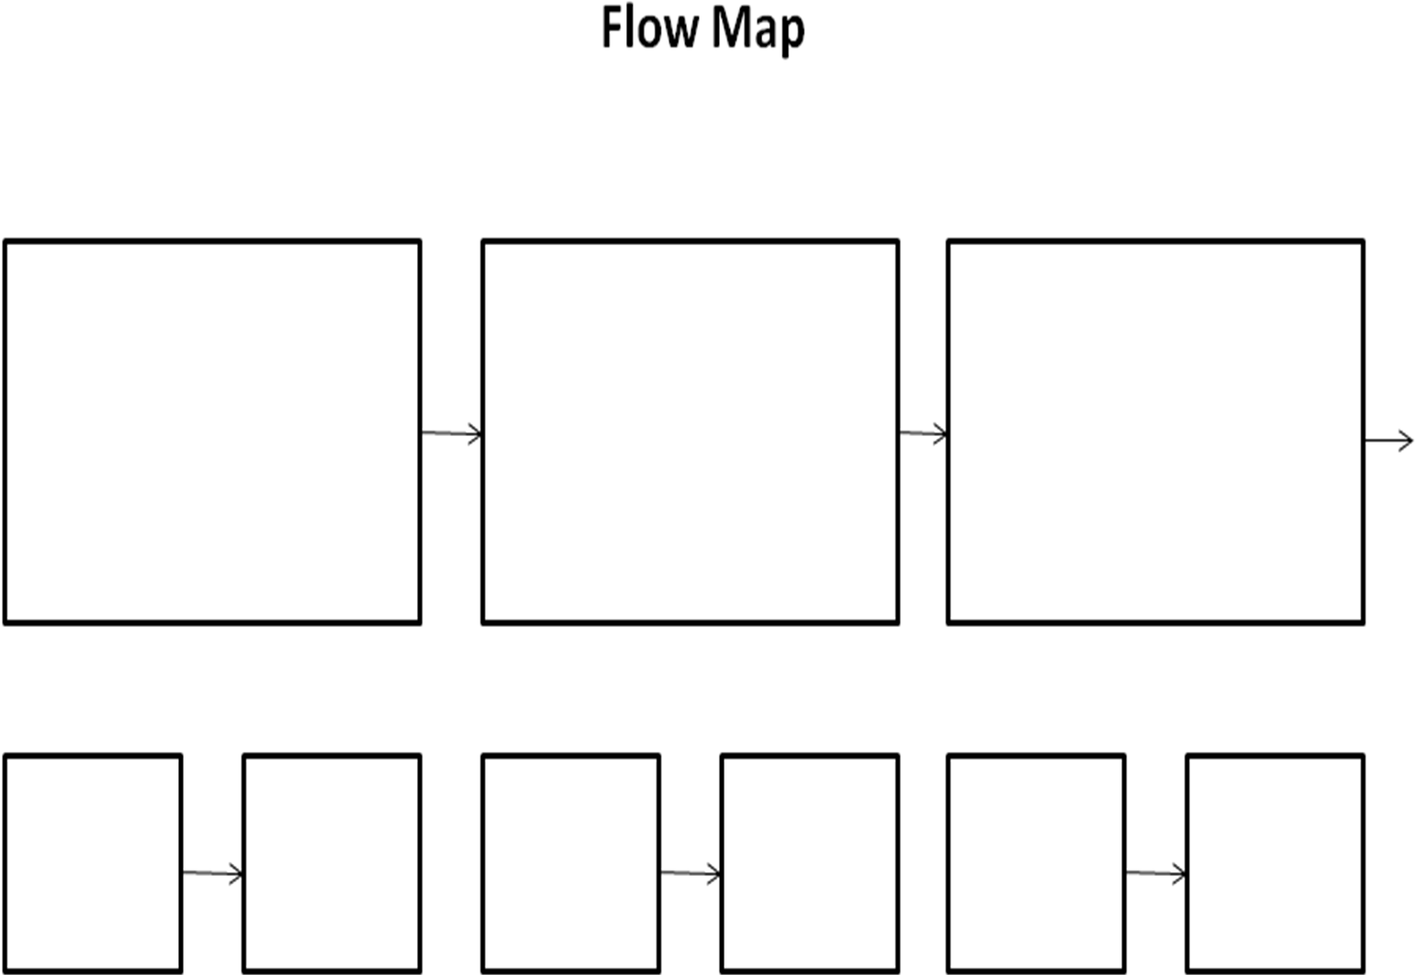

Slide 17
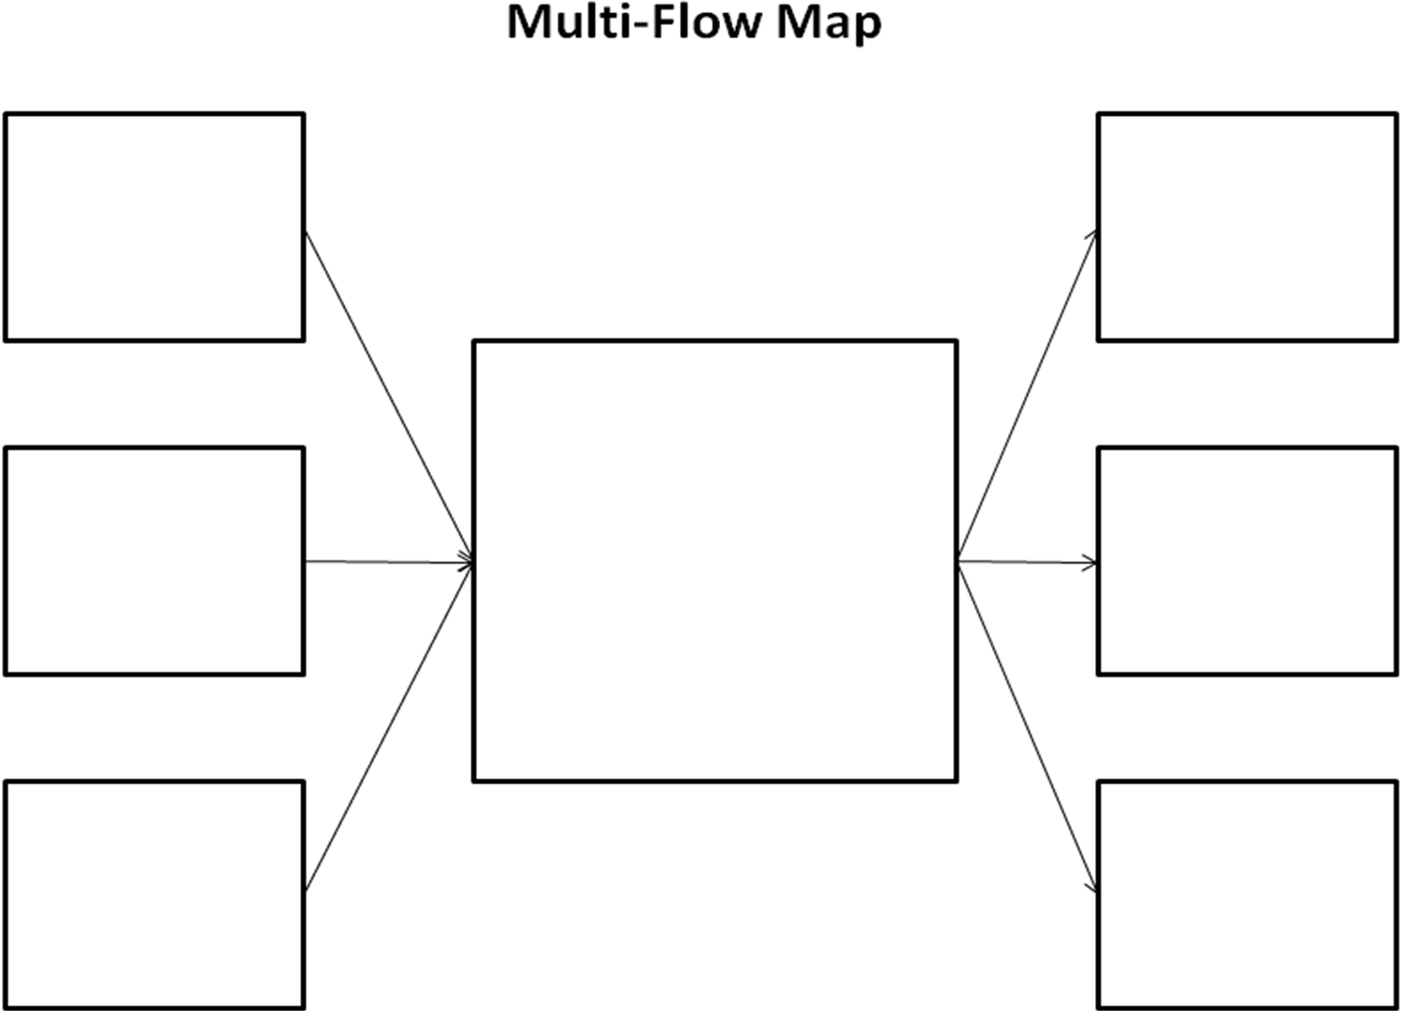

Slide 18
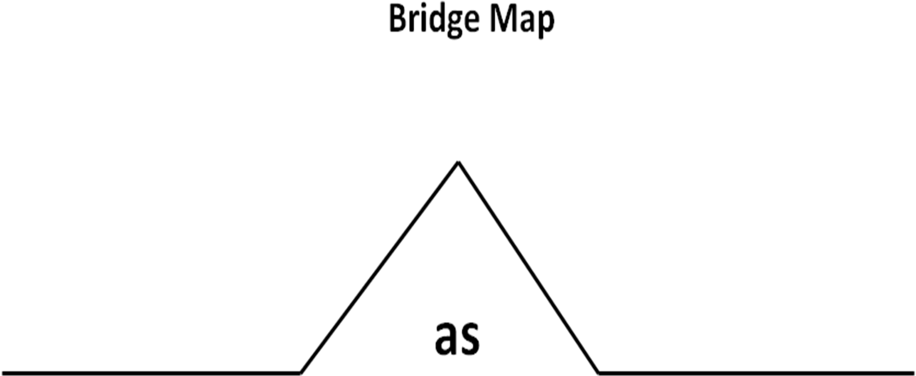

Slide 19
Before showing the Thinking Map examples…
Using the sticky notes and Thinking Maps provided, consider the following:
How would you/have you used them to support the teaching of reading?

Slide 20
Finally
For further information and resources:
http://www.oecd.org/pisa/pisaproducts/Draft%20PISA%202015%20Reading%20Framework%20.pdf

