Slide 1
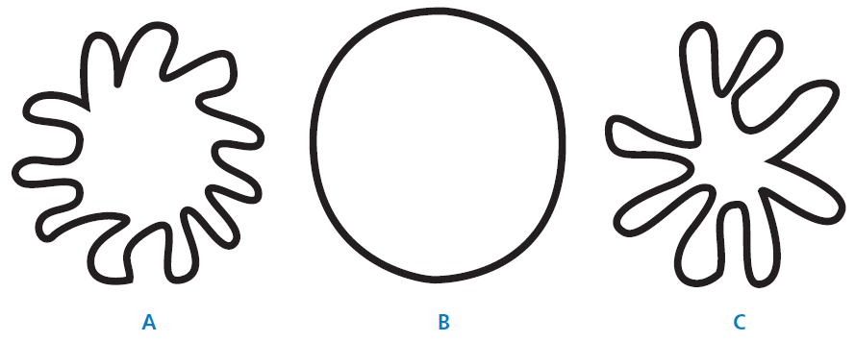
Mathematics Unit 30: Shapes
QUESTION 30.1
Which of the figures has the largest area?
Explain your reasoning.
What do we want to find out?
What useful information do we know?
What other mathematical techniques do we need to apply?
What have we learned?

Slide 2
Mathematics Unit 30: Shapes
QUESTION 30.1
Which of the figures has the largest area?
Explain your reasoning.
What do we want to find out?
What useful information do we know?
What other mathematical techniques do we need to apply?
What have we learned?
Back to start

Slide 3
Mathematics Unit 30: Shapes
QUESTION 30.1
Which of the figures has the largest area?
Explain your reasoning.
What do we want to find out?
What useful information do we know?
What other mathematical techniques do we need to apply?
What have we learned?
Back to start

Slide 4
Mathematics Unit 30: Shapes
QUESTION 30.1
Which of the figures has the largest area?
Explain your reasoning.
What do we want to find out?
What useful information do we know?
What other mathematical techniques do we need to apply?
What have we learned?
Back to start

Slide 5
Mathematics Unit 30: Shapes
QUESTION 30.1
Which of the figures has the largest area?
Explain your reasoning.
What do we want to find out?
What useful information do we know?
What other mathematical techniques do we need to apply?
What have we learned?
Back to start

Slide 6
Mathematics Unit 30: Shapes
QUESTION 30.2
Describe a method for estimating the area of figure C.
What do we want to find out?
What useful information do we know?
What other mathematical techniques do we need to apply?
What have we learned?

Slide 7
Mathematics Unit 30: Shapes
QUESTION 30.2
Describe a method for estimating the area of figure C.
What do we want to find out?
What useful information do we know?
What other mathematical techniques do we need to apply?
What have we learned?
Back to start

Slide 8
Mathematics Unit 30: Shapes
QUESTION 30.2
Describe a method for estimating the area of figure C.
What do we want to find out?
What useful information do we know?
What other mathematical techniques do we need to apply?
What have we learned?
Back to start

Slide 9
Mathematics Unit 30: Shapes
QUESTION 30.2
Describe a method for estimating the area of figure C.
What do we want to find out?
What useful information do we know?
What other mathematical techniques do we need to apply?
What have we learned?
Back to start

Slide 10
Mathematics Unit 30: Shapes
QUESTION 30.2
Describe a method for estimating the area of figure C.
What do we want to find out?
What useful information do we know?
What other mathematical techniques do we need to apply?
What have we learned?
Back to start

Slide 11
Mathematics Unit 30: Shapes
QUESTION 30.3
Describe a method for estimating the perimeter of figure C.
What do we want to find out?
What useful information do we know?
What other mathematical techniques do we need to apply?
What have we learned?

Slide 12
Mathematics Unit 30: Shapes
QUESTION 30.3
Describe a method for estimating the perimeter of figure C.
What do we want to find out?
What useful information do we know?
What other mathematical techniques do we need to apply?
What have we learned?
Back to start

Slide 13
Mathematics Unit 30: Shapes
QUESTION 30.3
Describe a method for estimating the perimeter of figure C.
What do we want to find out?
What useful information do we know?
What other mathematical techniques do we need to apply?
What have we learned?
Back to start

Slide 14
Mathematics Unit 30: Shapes
QUESTION 30.3
Describe a method for estimating the perimeter of figure C.
What do we want to find out?
What useful information do we know?
What other mathematical techniques do we need to apply?
What have we learned?
Back to start

Slide 15
Mathematics Unit 30: Shapes
QUESTION 30.3
Describe a method for estimating the perimeter of figure C.
What do we want to find out?
What useful information do we know?
What other mathematical techniques do we need to apply?
What have we learned?
Back to start

