Slide 1
Planning and organisation 2

Slide 2
Learning outcome
To produce visual planning aids
To understand planning at all levels including:
Timescales
Milestones and deadlines
Tasks and activities
Target setting
Resources required
Risk assessment
To apply this to a number of situations and the link to the Individual Project

Slide 3
Project and action planning
Project planning looks at how to start and how to complete a project within a certain timeframe, usually with defined stages, and with designated resources.
Project planning will usually include:
Setting SMART objectives
Identifying exactly what is to be produced
Planning the sequence of events
Making supporting plans (such as risk assessment and resource allocation)

Slide 4
Gantt chart
Label | Activity | 1 | 2 | 3 | 4 | 5 | 6 | 7 | 8 | 9 | 10 | 11 | 12 | 13 | 14 | 15 | 16 | 17 | 18 | 19 | 20
1 | Get frying pan
2 | Add small amount of oil
3 | Crack egg into pan (fry)
4 | Cut tomatoes
5 | Add tomatoes to pan (fry)
6 | Toast bread
7 | Get plate
8 | Butter toast
9 | Place toast on plate
10 | Place egg/ tomatoes on toast
11 | ??????
Notes:
What is this Gantt chart planning?
Why is it used?
What is the missing activity 11? (Eat breakfast)
Discussion of layer of Gantt chart- activity 3 lasts for 6 minutes- how do you know this?
http://post16consortium.wales/courses/welshBacc13/story.html - Link from consortia on Gantt charts

Slide 5
Over to you
Working in pairs create a Gantt chart for getting ready to leave the house in the morning.
Notes:
Class discussion of the process of completing the chart.
Class discussion of how the chart can help identify problems and plan for them

Slide 6
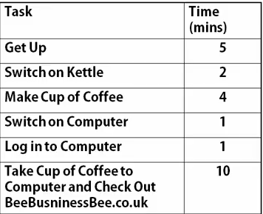
Network diagrams/ Critical Path Analysis
This is an alternative to Gantt charts giving a little more detail.
This clip looks at a simplistic morning routine.
Notes:
An alternative to Gantt charts for complex projects-
https://www.youtube.com/watch?v=-EqWGSdQSvI- Video clip looks a CPA development step by step
Use paper plates for large groups/ class to create a network diagram

Slide 7
Why plan?
Notes:
Think- Pair- Share followed by class discussion on the benefits of planning as a whole.
Ensure project is viable and realistic in relation to the resources available.
Identify the time constraints and work towards a deadline
Identify opportunities for development of project
Identify the resources required and sequence of the resources required

Slide 8
Time management
How well do you manage your time?
Are you always late or early?
Do you go slow and steady or rush work at the end working under pressure?
What are the impacts of your time management on your work?
Do you always meet deadlines?
Is there an impact on quality?
Rate yourself out of 10 for time management!
What do you need to improve?
How will you do it?
Notes:
http://post16consortium.wales/courses/welshBacc18/story.html
https://www.brookes.ac.uk/student/services/health/time.html

Slide 9
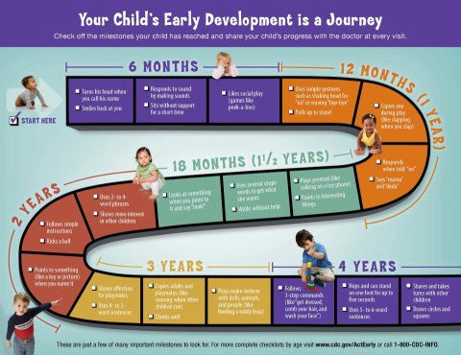
Milestones
Notes:
Consider the concept of milestones using child-development (image source Speechbuddy.com).
Discuss milestones being mini achievements towards the overall end goal- don’t run before you can walk concept.

Slide 10
Milestones
As a group consider the milestones you could set in planning your project- You may find the project guidance helpful.
Notes:
Issue students with project guidance from the specification to help.
Students could complete this using post it notes to make a more visual activity

Slide 11
Deadlines
Notes:
Centre to share deadlines with students for stages of the project and final project
Discussion of centre policy on meeting deadlines

Slide 12
Identifying tasks and activities
There isn’t only one way to complete a project, its important that you look at all the options and evaluate the best way before you start.
Look back at the classes lists for the process of getting up in the morning, all had the same outcome but there will be variation in how each pair went about it, now way was wrong they were just alternatives.

Slide 13
Identifying tasks and activities
Task | Activities
Gather primary research | Interview individuals | Carry out a focus group | Do online survey | Do face to face interview
 | Detailed information Time consuming | Varity of views Time consuming | Easy to set up Difficult get word out | Larger sample Time consuming
Present data | Computer produced charts | Hand drawn tally | Hand drawn charts | Computer tables
 | Easy to produce Data needs inputting | Easy to complete Mistakes cannot be changed will need to restart | Easy to produce Time consuming | Easy to produce Can be complex
Notes:
Discussion of how tasks can be met with several different activities and how to select the most appropriate activity depends on the task, the resources available, the time available and the required outcome.

Slide 14
Target setting
S | Specific | What exactly do I want to achieve? How? When? What are the conditions and limitations? Why exactly do I want to reach this goal? What are possible alternative ways of achieving the same?
M | Measurable | What will the end result be? How long will it be? When will it be completed?
A | Attainable | What is the best possible outcome? What would good look like? What would great look like? Can it be done?
R | Relevant | How will this impact on the overall outcome? What is the driving force?
T | Time related | What are the milestones? When is the deadline?

Slide 15
Target setting
Target 1
To produce a 15 question survey using Survey Monkey looking at the use of sports grounds in Colwyn Bay and have 50 responses by 15th January.
Target 2
To write my report answering all of my aims and objectives.
Notes:
Target 1- SMART
S- The reader can tell exactly what is going to be produced. M- 15 questions, 50 responses, A- It is within the capabilities of a student at this level- saying 50K responses wouldn’t be attainable for example, R- links clearly to a project (assuming the project is on sports grounds in Colwyn Bay) T- Clear date for completion.
Target 2- Not SMART
Class to re-write this to be a SMART target

Slide 16
Resources
Resources | Uses | Opportunities | Limitations | Other notes
Computers | Writing report/ Research on internet/ Creating charts and graphs. | Wide range of resources worldwide access. | Limited number available. | Can use during independent study time as well as lessons.
Library
Art room
Notes:
Class discussion what can we use? Add to the list given - Centre dependant.

Slide 17
Risks
Risk | Impact | Actions
Websites blocked | Limited access to some research topics due to area and establishment restrictions. | Identify websites at home.
Missed deadlines
Research safety
Accessing practical work rooms
Notes:
Discussion of risks- project specific- how can they be overcome?

