Slide 1
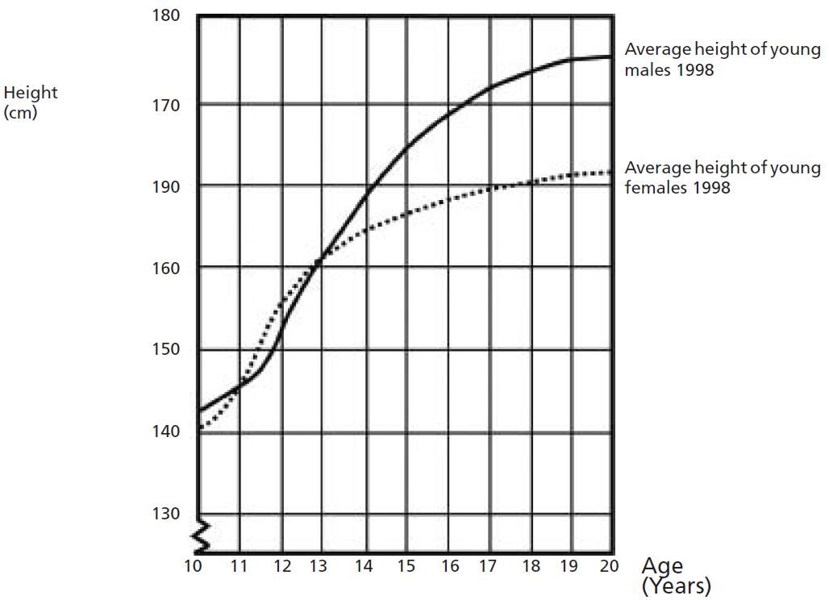
Mathematics Unit 6: Growing up
Youth grows taller
In 1998 the average height of both young males and young females in the Netherlands is represented in this graph.
QUESTION 6.1
Since 1980 the average height of 20-year-old females has increased by 2.3 cm, to 170.6 cm. What was the average height of a 20-year-old female in 1980?
What do we want to find out?
What useful information do we know?
What other mathematical techniques do we need to apply?
What have we learned?

Slide 2
Mathematics Unit 6: Growing up
Youth grows taller
In 1998 the average height of both young males and young females in the Netherlands is represented in this graph.
QUESTION 6.1
Since 1980 the average height of 20-year-old females has increased by 2.3 cm, to 170.6 cm. What was the average height of a 20-year-old female in 1980?
What do we want to find out?
What useful information do we know?
What other mathematical techniques do we need to apply?
What have we learned?
Back to start

Slide 3
Mathematics Unit 6: Growing up
Youth grows taller
In 1998 the average height of both young males and young females in the Netherlands is represented in this graph.
QUESTION 6.1
Since 1980 the average height of 20-year-old females has increased by 2.3 cm, to 170.6 cm. What was the average height of a 20-year-old female in 1980?
What do we want to find out?
What useful information do we know?
What other mathematical techniques do we need to apply?
What have we learned?
Back to start

Slide 4
Mathematics Unit 6: Growing up
Youth grows taller
In 1998 the average height of both young males and young females in the Netherlands is represented in this graph.
QUESTION 6.1
Since 1980 the average height of 20-year-old females has increased by 2.3 cm, to 170.6 cm. What was the average height of a 20-year-old female in 1980?
What do we want to find out?
What useful information do we know?
What other mathematical techniques do we need to apply?
What have we learned?
Back to start

Slide 5
Mathematics Unit 6: Growing up
Youth grows taller
In 1998 the average height of both young males and young females in the Netherlands is represented in this graph.
QUESTION 6.1
Since 1980 the average height of 20-year-old females has increased by 2.3 cm, to 170.6 cm. What was the average height of a 20-year-old female in 1980?
What do we want to find out?
What useful information do we know?
What other mathematical techniques do we need to apply?
What have we learned?
Back to start

Slide 6
Mathematics Unit 6: Growing up
Youth grows taller
In 1998 the average height of both young males and young females in the Netherlands is represented in this graph.
QUESTION 6.2
Explain how the graph shows that on average the growth rate for girls slows down after 12 years of age.
What do we want to find out?
What useful information do we know?
What other mathematical techniques do we need to apply?
What have we learned?

Slide 7
Mathematics Unit 6: Growing up
Youth grows taller
In 1998 the average height of both young males and young females in the Netherlands is represented in this graph.
QUESTION 6.2
Explain how the graph shows that on average the growth rate for girls slows down after 12 years of age.
What do we want to find out?
What useful information do we know?
What other mathematical techniques do we need to apply?
What have we learned?
Back to start

Slide 8
Mathematics Unit 6: Growing up
Youth grows taller
In 1998 the average height of both young males and young females in the Netherlands is represented in this graph.
QUESTION 6.2
Explain how the graph shows that on average the growth rate for girls slows down after 12 years of age.
What do we want to find out?
What useful information do we know?
What other mathematical techniques do we need to apply?
What have we learned?
Back to start

Slide 9
Mathematics Unit 6: Growing up
Youth grows taller
In 1998 the average height of both young males and young females in the Netherlands is represented in this graph.
QUESTION 6.2
Explain how the graph shows that on average the growth rate for girls slows down after 12 years of age.
What do we want to find out?
What useful information do we know?
What other mathematical techniques do we need to apply?
What have we learned?
Back to start

Slide 10
Mathematics Unit 6: Growing up
Youth grows taller
In 1998 the average height of both young males and young females in the Netherlands is represented in this graph.
QUESTION 6.2
Explain how the graph shows that on average the growth rate for girls slows down after 12 years of age.
What do we want to find out?
What useful information do we know?
What other mathematical techniques do we need to apply?
What have we learned?
Back to start

Slide 11
Mathematics Unit 6: Growing up
Youth grows taller
In 1998 the average height of both young males and young females in the Netherlands is represented in this graph.
QUESTION 6.3
According to this graph, on average, during which period in their life are females taller than males of the same age?
What do we want to find out?
What useful information do we know?
What other mathematical techniques do we need to apply?
What have we learned?

Slide 12
Mathematics Unit 6: Growing up
Youth grows taller
In 1998 the average height of both young males and young females in the Netherlands is represented in this graph.
QUESTION 6.3
According to this graph, on average, during which period in their life are females taller than males of the same age?
What do we want to find out?
What useful information do we know?
What other mathematical techniques do we need to apply?
What have we learned?
Back to start

Slide 13
Mathematics Unit 6: Growing up
Youth grows taller
In 1998 the average height of both young males and young females in the Netherlands is represented in this graph.
QUESTION 6.3
According to this graph, on average, during which period in their life are females taller than males of the same age?
What do we want to find out?
What useful information do we know?
What other mathematical techniques do we need to apply?
What have we learned?
Back to start

Slide 14
Mathematics Unit 6: Growing up
Youth grows taller
In 1998 the average height of both young males and young females in the Netherlands is represented in this graph.
QUESTION 6.3
According to this graph, on average, during which period in their life are females taller than males of the same age?
What do we want to find out?
What useful information do we know?
What other mathematical techniques do we need to apply?
What have we learned?
Back to start

Slide 15
Mathematics Unit 6: Growing up
Youth grows taller
In 1998 the average height of both young males and young females in the Netherlands is represented in this graph.
QUESTION 6.3
According to this graph, on average, during which period in their life are females taller than males of the same age?
What do we want to find out?
What useful information do we know?
What other mathematical techniques do we need to apply?
What have we learned?
Back to start

