Slide 1
Birthday Cake

Slide 2
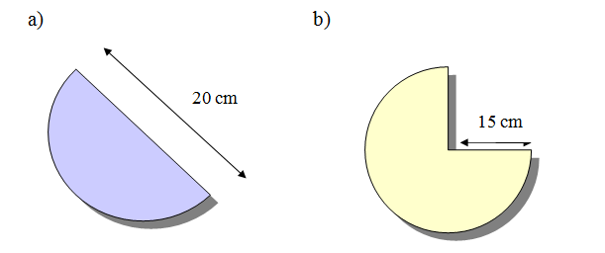
Starter
Find the area of these shapes:

Slide 3
Starter
Find the area of these shapes:
157.08 cm² (2 d.p.)
530.14 cm² (2 d.p.)

Slide 4
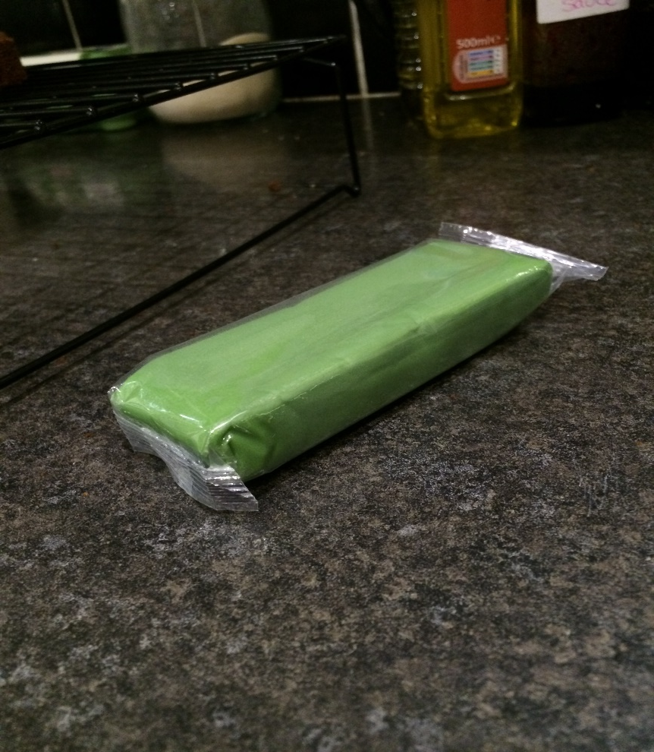
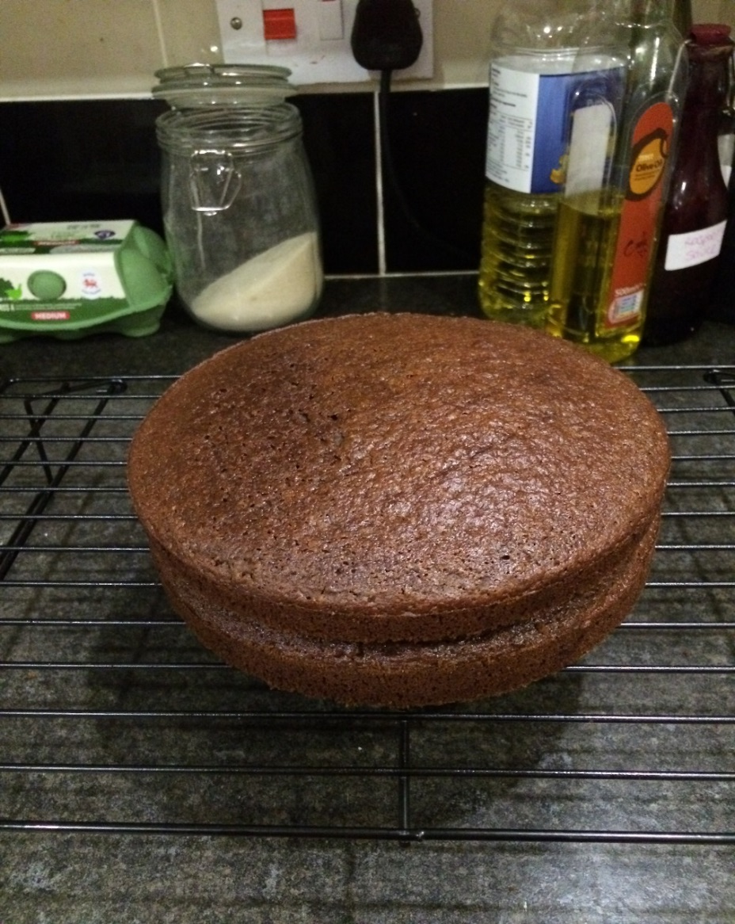
The problem…
Can I use this block of icing…
…to cover the top of this cake?
Notes:
I bought the icing as part of a 5 colour set to make an In the Night Garden themed cake. I mainly wanted the blue and red icing to make Iggle Piggle, and was wondering if the green from the set would be enough to cover the top of the cake to look like grass.

Slide 5
What do we need to know?
THINK
PAIR
SHARE
Try to use mathematical words

Slide 6
Today’s objectives
To apply prior knowledge to solve a practical problem and make informed decisions.
To think about how practical our solutions would be in a real-life situation.
Prior knowledge:
Volume of cuboid
Area of a circle
Volume of a cylinder
Circumference of a circle
Metric units of measurement
Notes:
You may wish to conceal the prior knowledge topics at this stage so that pupils identify the methods independently.

Slide 7
Need to know:
The block of icing measures 11cm x 4cm x 2cm.
The diameter of the cake is 18cm.
The icing needs to be 5mm thick.
Only the top of the cake needs to be covered.
Can it be done?
Notes:
These can be shown, or withheld until pupils ask for the information.

Slide 8
Peer assessment
Swap your work with someone else and peer assess the working.
Think:
Is it easy to follow what they’ve done?
Do you agree with their method and their solution?
Can you suggest how they can improve their work?

Slide 9
Solution
Volume of the icing block = length x width x height
= 11 x 4 x 2
= 88 cm³
Volume needed = Area of the top of the cake x 5mm (0.5cm) thick
= πr²h
= π x 9² x 0.5
= 127.23 cm³ (2 d.p.)
So…not quite!

Slide 10
Talking points
Think:
How significant is this answer?
Can you visualise the difference?
In real life, what might you do in this situation?
Ext:
How thin would we need to roll the icing to make it fit the top of the cake?

Slide 11
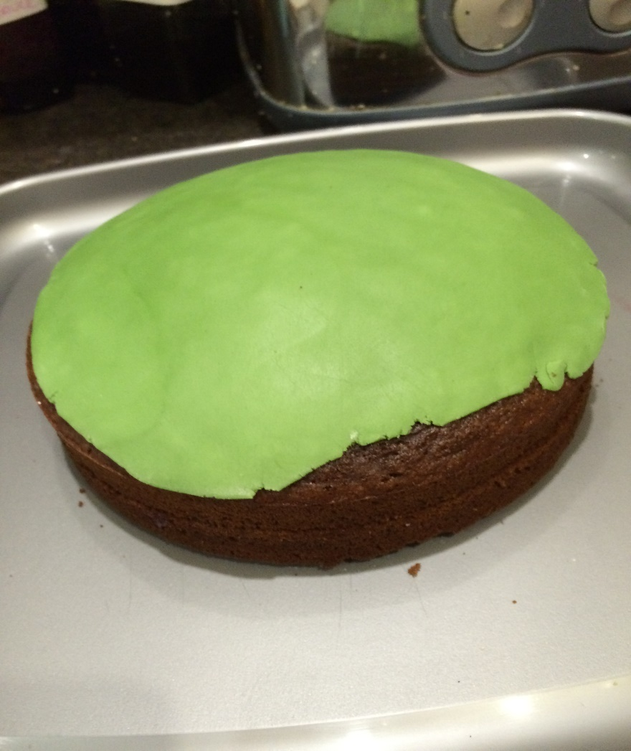
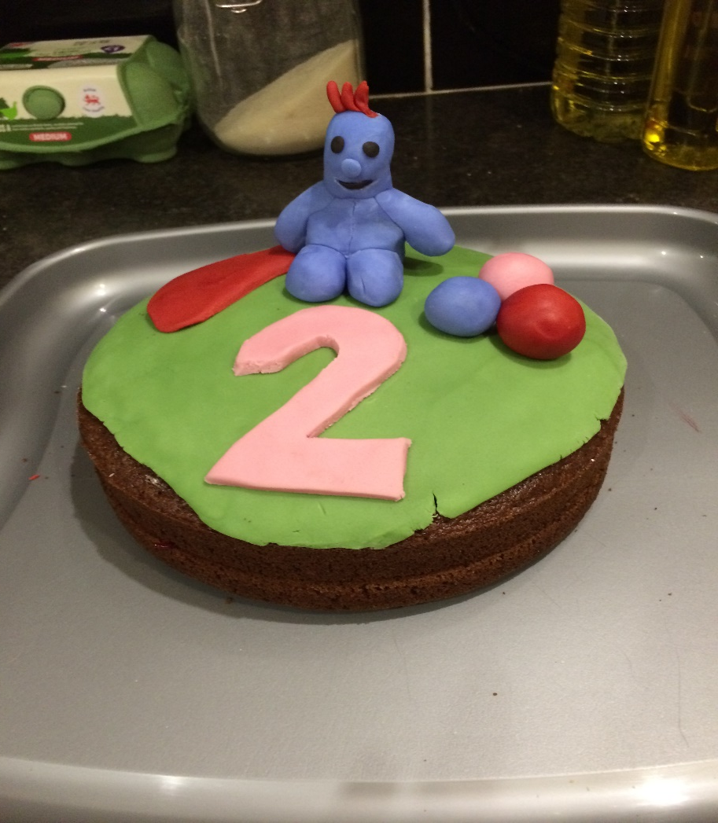
I decided to try and do it anyway! I rolled it out as thin as I could…
(it was quite tricky!!)

Slide 12
…and used Smarties around the edge to cover the gaps…
Think:
What mathematical questions could we ask?
How many Smarties will I need?
What do we need to know?

Slide 13
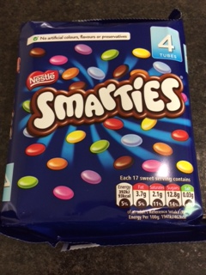
Need to know…
The diameter of a Smartie is 1.5cm.
We can work out the circumference of the cake.
Useful to know…
I’ve got 4 tubes of Smarties.
Each tube contains approximately 30 Smarties.

Slide 14
Solution
Circumference of the cake = πd
= π x 18
= 56.55 (2 d.p.)
÷ 1.5 = 37.7 Smarties
How would you interpret this answer?

Slide 15
Finished!

Slide 16
Today’s objectives
To apply prior knowledge to solve a practical problem and make an informed decisions.
To think about how practical our solutions would be in a real-life situation.
Prior knowledge:
Volume of cuboid
Area of a circle
Volume of a cylinder
Circumference of a circle
Notes:
You may wish to conceal the prior knowledge topics at this stage so that pupils identify the methods independently.

Slide 17
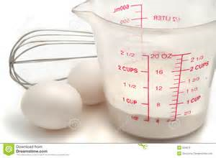
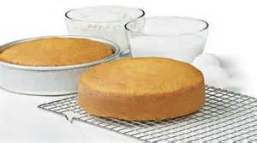
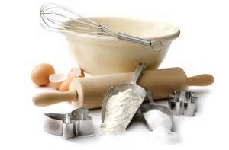
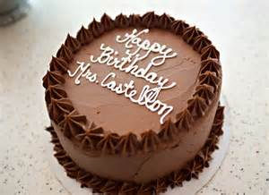
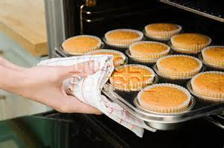
Plenary
What other mathematical problems /questions could arise from baking cakes?
Notes:
Pictures can be shown as stimulus or left out

Slide 18
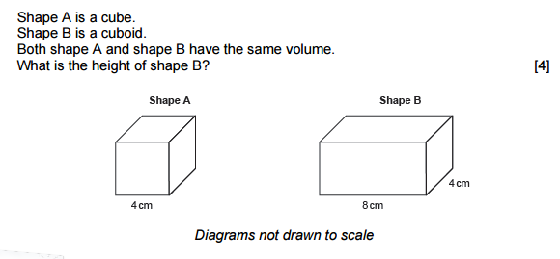
Exam question
GCSE MATHEMATICS UNIT 2: CALCULATOR-ALLOWED
INTERMEDIATE TIER SPECIMEN PAPER SUMMER 2017
4 × 4 × 4
=64 (cm³)
64 / (8×4) or 32h=64
=2 (cm)

