Slide 1
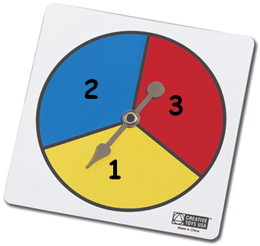
11/02/2015
Level 7/8
Sampling
Complete the questions on the sheet.
The bottom question is a fully answered example to help you if you are unsure

Slide 2
27÷50=0.54
13÷50=0.26
10÷50=0.2
50
Q1) Do you think the spinner is fair? Explain your answer.
No. It seems that number 1 is over twice as likely to appear than the others.
Q2) a) If the spinner was spun 400 times, how many 2’s would he expect?
b) If the spinner was spun 580 times, how many 1’s would he expect?
0.26 × 400 = 104 104
0.54 × 580 = 313.2 313
Q3) Suppose you play a game where it costs you 10p each time you spin.
If you spin a 3 you win 50p. You start with £20
How much money will you have if you play the game 1,000 times?
Cost = 1,000 × 10p = £100
Winnings = 0.2 × 1,000 × 50p = £100
He should still have £20.

Slide 3
Activate
I want your opinion Years 7-11. I won’t ask all of you.
I’ll ask a sample of you.
Lets say 50.
But how can I do it fairly?

Slide 4
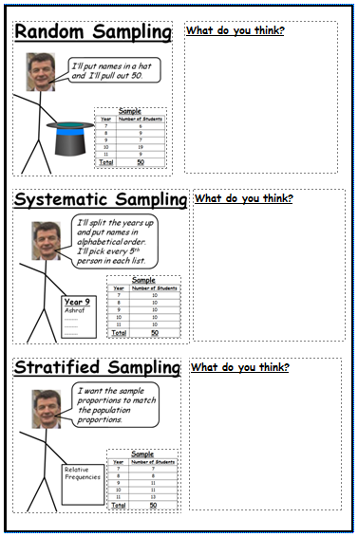
Demonstrate
Read through the three ways of sampling
Discuss in pairs what you think of each.
Make notes on one of the pages.

Slide 5
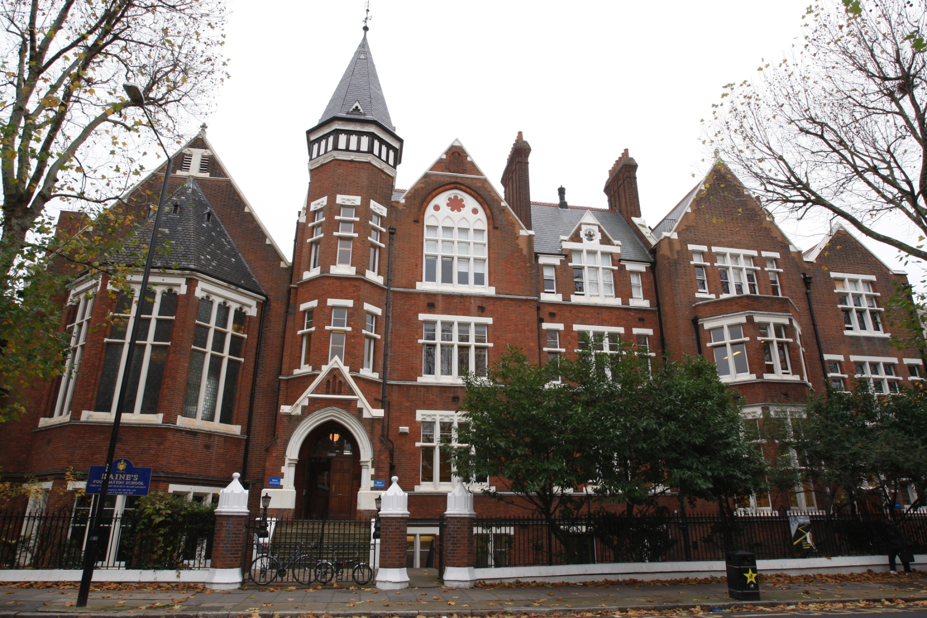
Activate
Year | Number of Students
7 | 80
8 | 90
9 | 115
10 | 125
11 | 140
Total | 550

Slide 6
Activate
Population
Year | Number of Students
7 | 80
8 | 90
9 | 115
10 | 125
11 | 140
Total | 550
Random Sampling
I’ll put names in a hat and I’ll pull out 50.
Sample
Year | Number of Students
7 | 6
8 | 9
9 | 7
10 | 19
11 | 9
Total | 50

Slide 7
Activate
Population
Year | Number of Students
7 | 80
8 | 90
9 | 115
10 | 125
11 | 140
Total | 550
Systematic Sampling
I’ll split the years up and put names in alphabetical order. I’ll pick every 5th person in each list.
Sample
Year | Number of Students
7 | 10
8 | 10
9 | 10
10 | 10
11 | 10
Total | 50
Year 9
Ashraf
.........
.........
.........

Slide 8
Activate
Population
Year | Number of Students
7 | 80
8 | 90
9 | 115
10 | 125
11 | 140
Total | 550
Stratified Sampling
I want the sample proportions to match the population proportions.
Sample
Year | Number of Students
7 | 7
8 | 8
9 | 11
10 | 11
11 | 13
Total | 50
Relative
Frequencies

Slide 9
Activate
Stratified Sampling
Year | Number of Students
7 | 80
8 | 90
9 | 115
10 | 125
11 | 140
Total | 550
Relative Frequency
80 ÷ 550 = 0.145
90 ÷ 550 = 0.164
115 ÷ 550 = 0.21
125 ÷ 550 = 0.227
140 ÷ 550 = 0.255

Slide 10
Activate
Year | Number of Students
7 | 80
8 | 90
9 | 115
10 | 125
11 | 140
Total | 550
Relative Frequency
80 ÷ 550 = 0.145
90 ÷ 550 = 0.164
115 ÷ 550 = 0.21
125 ÷ 550 = 0.227
140 ÷ 550 = 0.255
How many students from year 7 should be in the sample?
Relative Frequency × Sample Size
7
0.145 × 50 = 7.25 ≈

Slide 11
Activate
Year | Number of Students
7 | 80
8 | 90
9 | 115
10 | 125
11 | 140
Total | 550
Relative Frequency
80 ÷ 550 = 0.145
90 ÷ 550 = 0.164
115 ÷ 550 = 0.21
125 ÷ 550 = 0.227
140 ÷ 550 = 0.255
How many students from year 8 should be in the sample?
Relative Frequency × Sample Size
8
0.164 × 50 = 8.2 ≈

Slide 12
Activate
Year | Number of Students
7 | 80
8 | 90
9 | 115
10 | 125
11 | 140
Total | 550
Relative Frequency
80 ÷ 550 = 0.145
90 ÷ 550 = 0.164
115 ÷ 550 = 0.21
125 ÷ 550 = 0.227
140 ÷ 550 = 0.255
How many students from year 9 should be in the sample?
Relative Frequency × Sample Size
11
0.21 × 50 = 10.5 ≈

Slide 13
Activate
Year | Number of Students
7 | 80
8 | 90
9 | 115
10 | 125
11 | 140
Total | 550
Relative Frequency
80 ÷ 550 = 0.145
90 ÷ 550 = 0.164
115 ÷ 550 = 0.21
125 ÷ 550 = 0.227
140 ÷ 550 = 0.255
How many students from year 10 should be in the sample?
Relative Frequency × Sample Size
11
0.227 × 50 = 11.35 ≈

Slide 14
Activate
Year | Number of Students
7 | 80
8 | 90
9 | 115
10 | 125
11 | 140
Total | 550
Relative Frequency
80 ÷ 550 = 0.145
90 ÷ 550 = 0.164
115 ÷ 550 = 0.21
125 ÷ 550 = 0.227
140 ÷ 550 = 0.255
How many students from year 11 should be in the sample?
Relative Frequency × Sample Size
13
0.255 × 50 = 12.75 ≈

Slide 15
Demonstrate
In your book complete the questions on the worksheet.
Do not copy out the tables!
Start on Q3)
Answers are at the back of the worksheet.
Of course you must show your workings!
Start on Q2)
Start on Q1)

Slide 16
Plenary
In Mr Bradshaw’s previous school he took a sample of 120 students.
In his sample there were 52 girls.
The school had 960 students.
How many girls would have been in the school?
52 ÷ 120 = 0.433.......
≈ 416 girls
0.433 × 960 = 415.68

Slide 17
Plenary
WWW:
EBI:

